Slide 1


Analyzing amazon dataset for SQL queries
- Sneha Kumari
snehakumari

Slide 2
01
02
03
04
05
06
07
08
09
10
Dataset Used
Products with Discounted Price Below Rs.500
Products with 50% or More Discount
Products with 20% to 49% Discount
Products having actual price above 1000 with a rating of 4 stars or above
Products where discounted price and actual price ends with a ‘9’
Products with ‘Phone’ in the Name
List of all products where Category of the product is Technology
Difference between actual price and discounted price of each product
Product Delivery Time
Contents
snehakumari

Slide 3
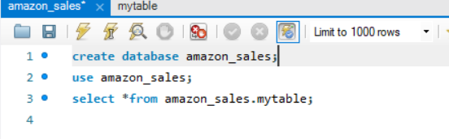
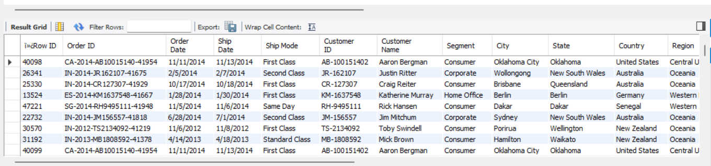
Dataset Used
snehakumari

Slide 4
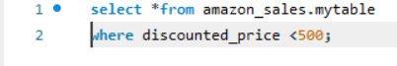
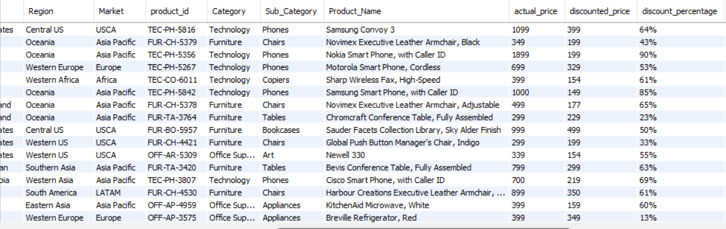
Products with Discounted Price Below Rs.500
Finding budget-friendly products under ₹500 for price-sensitive customers.
snehakumari

Slide 5

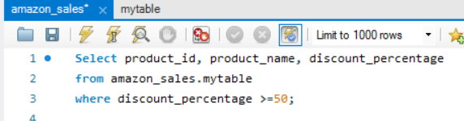
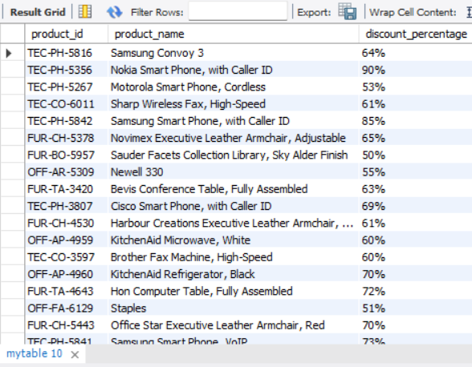

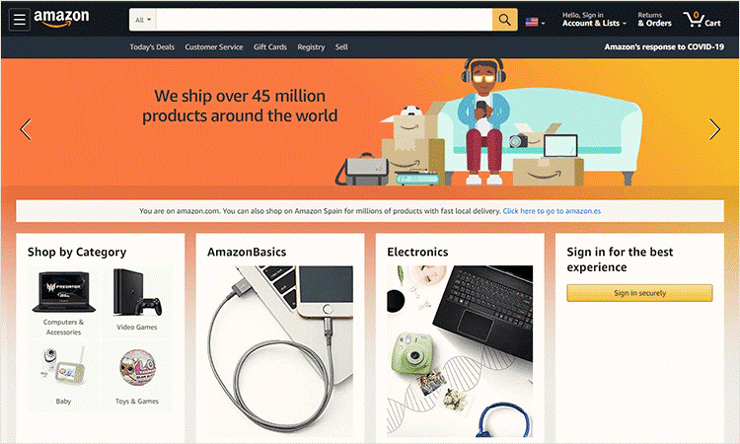
Products with 50% or More Discount
Highlight items with 50%+ discounts for significant sales opportunities in promotional campaigns, aiding in finding heavily discounted items.
snehakumari

Slide 6
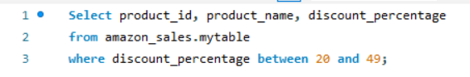
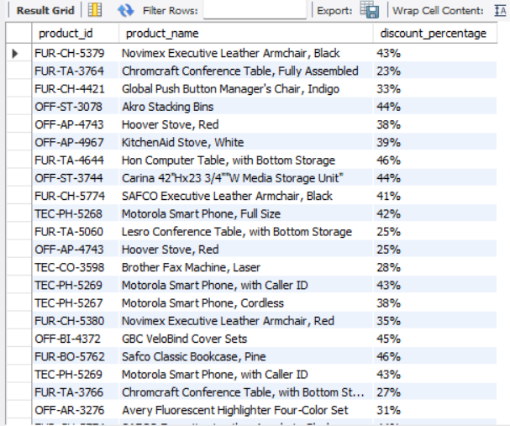
Products with 20% to 49% Discount
This query is used to find products with discounts between 20% and 40%, aiding in identifying products with moderate discounts, useful for sales analysis focusing on specific discount ranges.
snehakumari

Slide 7
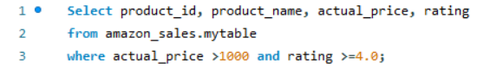
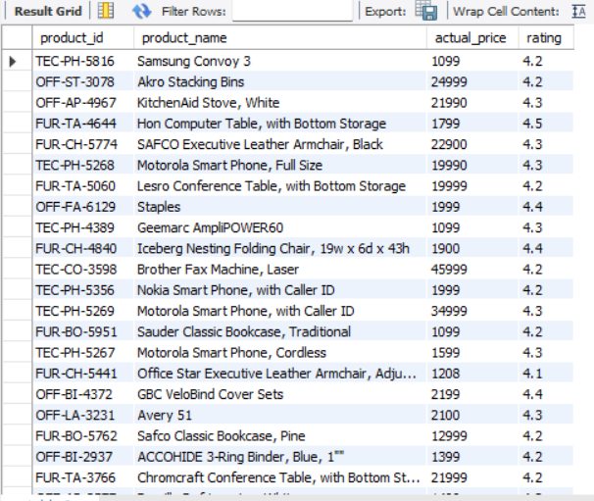
Products having actual price above 1000 with a rating of 4 stars or above
Focus on products that are priced higher, which might indicate better quality or premium features. By filtering for products with high ratings, businesses can ensure they are promoting items that have been well-received by customers.
snehakumari

Slide 8
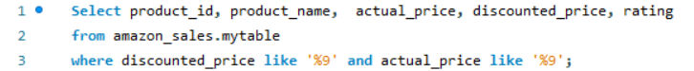


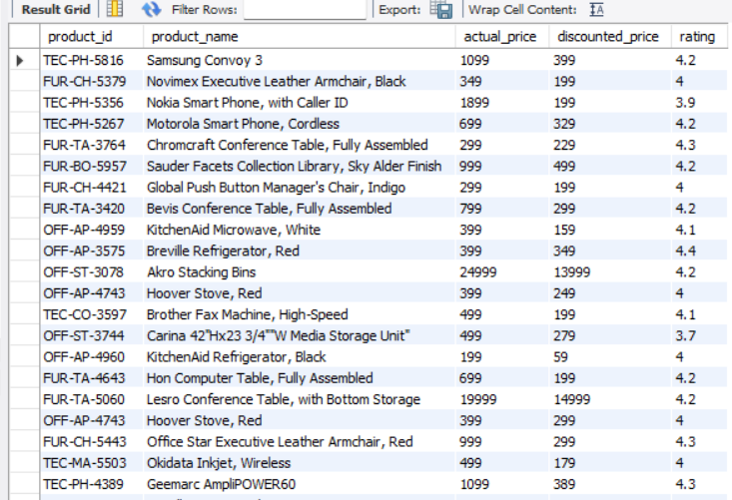
Products where discounted price and actual price ends with a ‘9’
This query provides insights into pricing, promotions, sales, customer behavior, and inventory for prices ending in 9.
snehakumari

Slide 9
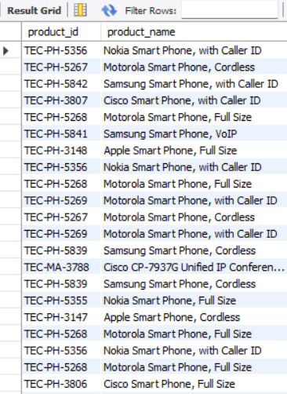
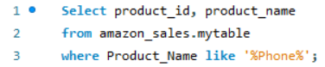
Products with ‘Phone’ in the Name
This query finds products with “Phone” in the name, aiding in:
Product search for phones
Inventory management and categorization
Targeted marketing campaigns
Customer support efficiency
Sales analysis for phone products
Reporting on phone product performance, pricing, and availability
snehakumari

Slide 10
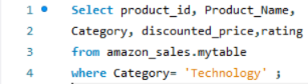
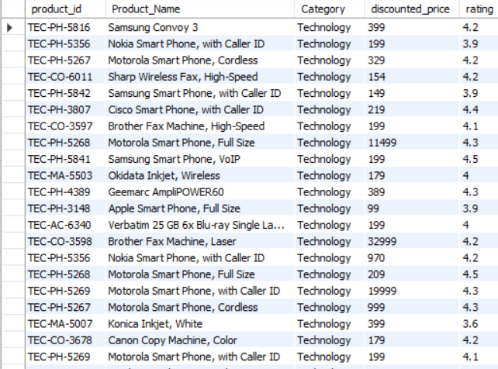
List of all products where Category of the product is Technology
This query retrieves products in the “Technology” category, useful for:
Category analysis
Inventory management
Sales performance tracking
Promotional strategies
Product development
snehakumari

Slide 11
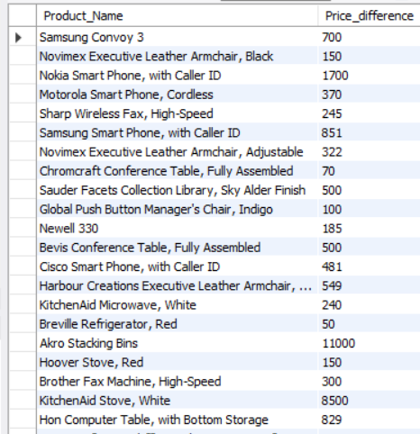

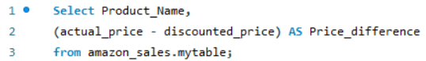
Difference between actual price and discounted price of each product
This query calculates the difference between the actual and discounted prices for each product. It helps businesses and customers understand the savings achieved through discounts.
snehakumari

Slide 12
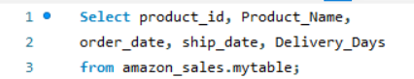
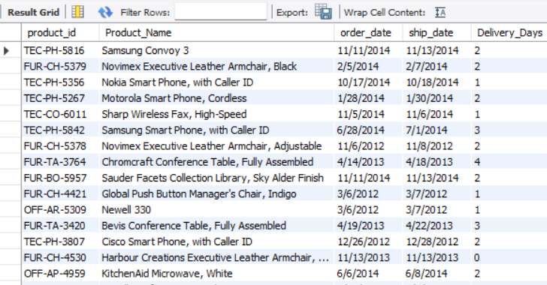
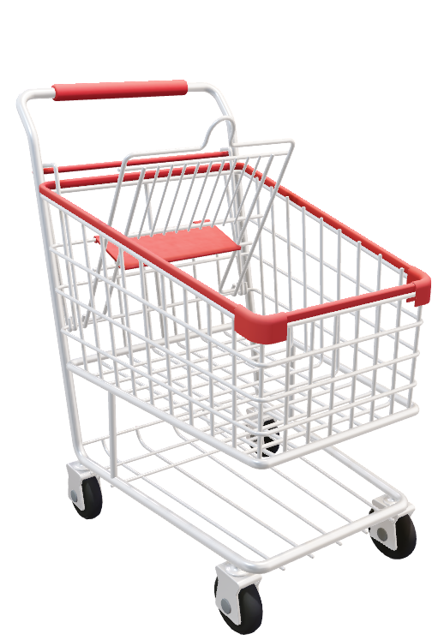
Product Delivery Time
Product Delivery Time refers to the period between when an order is placed and when it is delivered to the customer. This metric is crucial for both businesses and customers, as it impacts customer satisfaction, inventory management, and operational efficiency.
snehakumari

Slide 13
thanks!
- Sneha Kumari
snehakumari

